Slide 1

Experimented and Presented by
Md. Istiak Ahammed
ID: 2024100207
Robot and Smart System Engineering

Slide 2

Outlines
Introduction
Proposed Ensemble Learning Approach
XGBoost (eXtreme Gradient Boosting)
Experimental Design
Results and Discussion
Conclusion

Slide 3
Introduction
General Background
→ Energy efficiency in buildings is crucial for environmental and economic benefits.
→ Accurate energy load prediction (Heating and Cooling) helps in designing energy-efficient buildings.
→ Machine learning methods have been increasingly used for this purpose due to their predictive power and efficiency.
Problems
→ Traditional machine learning methods often suffer from overfitting, leading to inaccurate predictions.
→ There is a need for models that can handle high-dimensional data and avoid overfitting while providing accurate predictions.

Slide 4
Introduction
Previous Gap
→ Existing methods lack robustness and fail to generalize well, especially in complex scenarios with high-dimensional data.
→ Overfitting is a common problem that undermines the reliability of predictions in traditional models.
Research Objectives
→ Develop an ensemble learning approach using the XGBoost algorithm to improve load prediction accuracy and robustness.
→ Conduct extensive experiments to validate the proposed approach against traditional methods.
→ Demonstrate the effectiveness of XGBoost in predicting energy loads in residential buildings, aiming for high accuracy and generalizability.

Slide 5







Proposed Ensemble Learning Approach
Ensemble Learning
Good
Good
Good
Tom Cruise
Bad
Bad

Slide 6
XGBoost (eXtreme Gradient Boosting)
- XGBoost (eXtreme Gradient Boosting) is a powerful and efficient implementation of the gradient boosting framework and able to adjust its scale when needed.
- Developed by Tianqi Chen, XGBoost is known for its performance and speed
Age | BMI | Height | Pred
21 | 24 | 174 | 173
22 | 26 | 176 | 173
23 | 30 | 169 | 173
Gradient Boost
Actual Height | Pred Height | Residual | Pred Residual
174 | 173 | 1 | 1.5
176 | 173 | 3 | 5
169 | 173 | -4 | -1
Step1→ Start by computing the initial prediction, which is often the mean of the target values
Step 2→ Compute Residuals: Calculate the difference between the actual values and the predicted values
Step 3 → Train a new model (typically a decision tree) to predict the residuals.
Step 4 → Update the initial predictions by adding the predictions of the residuals, multiplied by the learning rate.
Final prediction =Base value + (LR x 1st PredRes by RM1) + (LR X 2nd PredRes by RM2)+….
= 173 + (0.1X1.5) + (0.1 X 1.2) +……………
The new prediction after first iteration: 173 + learning rate (0.1) x Pred Residual (1.5)

Slide 7
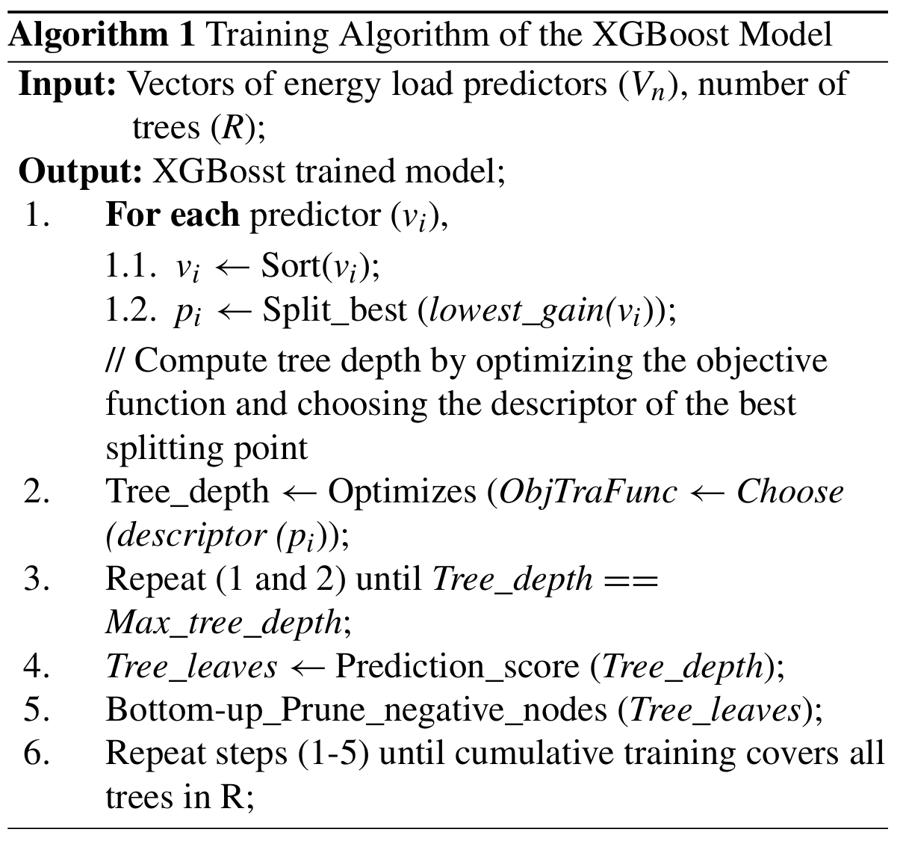
XGBoost (eXtreme Gradient Boosting)
XGBoost Algorithm
Step 1: Sort and split each predictor (input variable) to find the best splitting point.
Step 2: Optimize the tree depth by choosing the best splitting descriptor.
Step 3: Repeat steps 1 and 2 until you reach the maximum tree depth.
Step 4: Calculate the prediction score for each tree leaf.
Step 5: Prune (remove) nodes with negative scores.
Step 6: Repeat the entire process for all trees in the model.

Slide 8
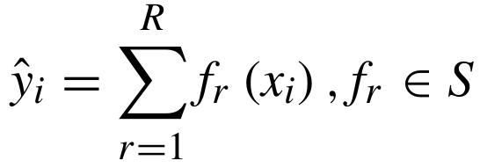
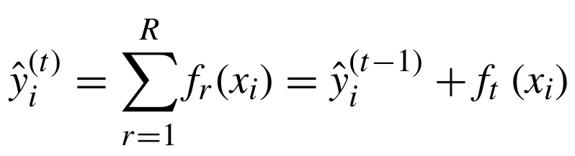
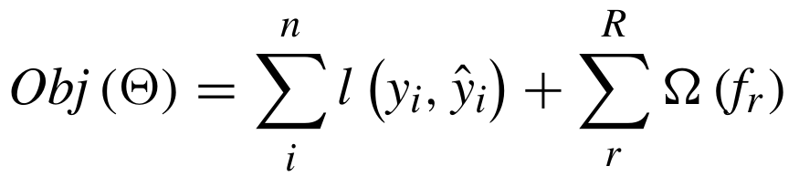
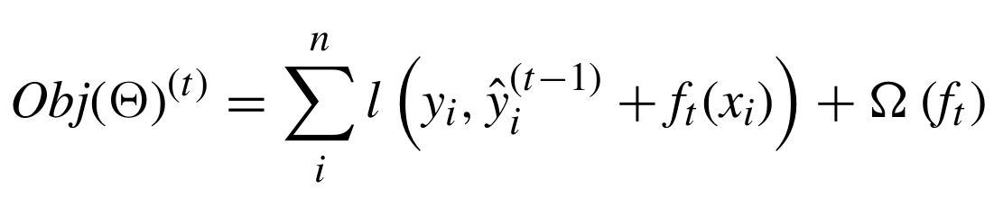
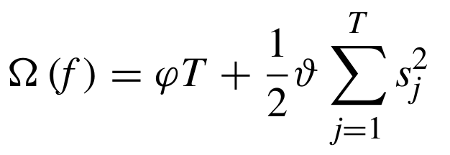
XGBoost (eXtreme Gradient Boosting)
Mathematical Equation of XGBoost Algorithm
Predicted Score Sum
Updated Prediction
Objective Function
Simplified Objective Function
Regularization Term
$$f_{r}=Independent tree with scores of each leaf$$
l $=differentialbe loss function between actual \& predicted$
Ω = regularization term to avoid overfitting
$$T=leaf count, s=leaf score, φ and θ=controlling constant for regularization$$

Slide 9
Experimental Design
Dataset
Dataset Source: The dataset used is from a simulation of various residential building designs created with Ecotec software, which publicly available. Number of Samples: 768 samples
Name | Unit
Overall height | m
Relative compactness | NA
Wall area | m²
Surface area | m²
Roof area | m²
Glazing area distribution | NA
Glazing area | m²
Orientation | Direction
Name | Unit
Cooling load (CL) | kW
Heating load (HL) | kW
Input Attributes
Output Responses

Slide 10
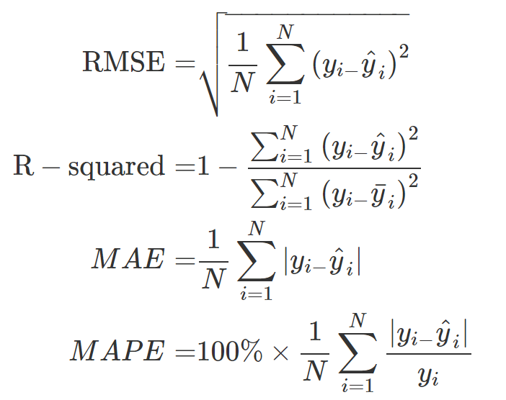
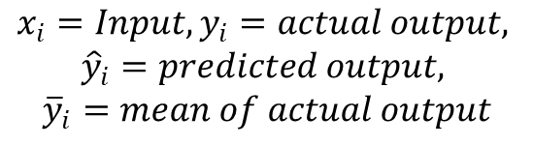
Experimental Design
Performance Metrics
The performance metrics used to evaluate the proposed energy prediction model are statistical measures.
from sklearn.metrics import mean_absolute_error, mean_squared_error, r2_score, mean_absolute_percentage_error
# Calculate performance metrics for HL and CL
mae_hl = mean_absolute_error(y_test_hl, y_pred_hl)
rmse_hl = np.sqrt(mean_squared_error(y_test_hl, y_pred_hl))
mape_hl = mean_absolute_percentage_error(y_test_hl, y_pred_hl) * 100
r2_hl = r2_score(y_test_hl, y_pred_hl)
mae_cl = mean_absolute_error(y_test_cl, y_pred_cl)
rmse_cl = np.sqrt(mean_squared_error(y_test_cl, y_pred_cl))
mape_cl = mean_absolute_percentage_error(y_test_cl, y_pred_cl) * 100
r2_cl = r2_score(y_test_cl, y_pred_cl)
$$x_{i}=Input, y_{i}=actual output,$$
$${\hat{y}}_{i}=predicted output,$$
$${\overline{y}}_{i}=mean of actual output$$

Slide 11
Experimental Design
Parameter Initialization for XGBoost (Grid Search)
Parameter | Description | Paper’s value | Experiment’s value
learning_rate | Step size shrinkage used to prevent overfitting | 0.1 | 0.1
gamma | Minimum loss reduction to make a split | 0 | 0
max_depth | Maximum depth of a tree | 150 | 100
n_estimators | Number of boosting rounds | 2000 | 2000
reg_alpha | L1 regularization term on weights | 0.01 | 0.1
reg_lambda | L2 regularization term on weights | 0.8 | 1
subsample | Fraction of samples used for fitting each tree | 0.7/0.75 (HL/CL) | 0.8
colsample_bytree | Fraction of features used for each tree | 0.7 | 0.7
min_child_weight | Whether to print running messages | 1.8 | 1

Slide 12
Experimental Design
Training and Testing
Loading dataset and initializing counter C=1
10-fold cross-validation has been conducted
Energy efficiency dataset is divided into 10 folds
9 of them are utilized to train the model, and the remaining fold is applied for testing.
Repeated this step 10 times, each time a different fold from the dataset is used for testing and the remaining 9 folds for training
Hyper parameters has defined by using Grid Search techniques
Dividing dataset using 10- fold CV
10-folds (F1, F2, …, F10)
Selecting different combination for training and testing (9-training and 1-testing)
9-folds for training the XGBoost
1-fold for testing the XGBoost
Computing results
Flowchart
Increasing counter
C = C + 1
Compute average results
Yes
If C>10
No

Slide 13
# Perform 10-fold cross-validation
kf = KFold(n_splits=10, shuffle=True, random_state=42)
results_hl = []
results_cl = []
actual_vs_predicted_hl = []
actual_vs_predicted_cl = []
fold = 1
for train_index, test_index in kf.split(X):
X_train, X_test = X.iloc[train_index], X.iloc[test_index]
y_train_hl, y_test_hl = y_hl.iloc[train_index], y_hl.iloc[test_index]
y_train_cl, y_test_cl = y_cl.iloc[train_index], y_cl.iloc[test_index]
# Train the models
xgb_model_hl.fit(X_train, y_train_hl)
xgb_model_cl.fit(X_train, y_train_cl)
# Predict
y_pred_hl = xgb_model_hl.predict(X_test)
y_pred_cl = xgb_model_cl.predict(X_test)
# Collect actual vs predicted values
actual_vs_predicted_hl.append((y_test_hl, y_pred_hl))
actual_vs_predicted_cl.append((y_test_cl, y_pred_cl))
# Calculate performance metrics
mae_hl = mean_absolute_error(y_test_hl, y_pred_hl)
rmse_hl = np.sqrt(mean_squared_error(y_test_hl, y_pred_hl))
mape_hl = mean_absolute_percentage_error(y_test_hl, y_pred_hl) * 100
r2_hl = r2_score(y_test_hl, y_pred_hl)
mae_cl = mean_absolute_error(y_test_cl, y_pred_cl)
rmse_cl = np.sqrt(mean_squared_error(y_test_cl, y_pred_cl))
mape_cl = mean_absolute_percentage_error(y_test_cl, y_pred_cl) * 100
r2_cl = r2_score(y_test_cl, y_pred_cl)
results_hl.append([fold, mae_hl, rmse_hl, mape_hl, r2_hl])
results_cl.append([fold, mae_cl, rmse_cl, mape_cl, r2_cl])
fold += 1
Experimental Design
Training and Testing Code
# Load dataset
data = pd.read_csv('../data/ENB2012_data_with_columns.csv')
# Check for NaN values and replace or drop them
data = data.replace([np.inf, -np.inf], np.nan)
data = data.dropna()
# Define input and output variables
X = data.iloc[:, :-2]
y_hl = data['Heating_Load']
y_cl = data['Cooling_Load']
# Initialize models with best parameters
best_params_hl = {'colsample_bytree': 0.7, 'gamma': 0, 'learning_rate': 0.1, 'max_depth': 150, 'min_child_weight': 1.8, 'n_estimators': 2000, 'reg_alpha': 0.01, 'reg_lambda': 0.8, 'subsample': 0.7, 'silent': 1, 'nthread': -1}
best_params_cl = {'colsample_bytree': 0.7, 'gamma': 0, 'learning_rate': 0.1, 'max_depth': 150, 'min_child_weight': 1.8, 'n_estimators': 2000, 'reg_alpha': 0.01, 'reg_lambda': 0.8, 'subsample': 0.75, 'silent': 1, 'nthread': -1}
xgb_model_hl = XGBRegressor(**best_params_hl)
xgb_model_cl = XGBRegressor(**best_params_cl)

Slide 14
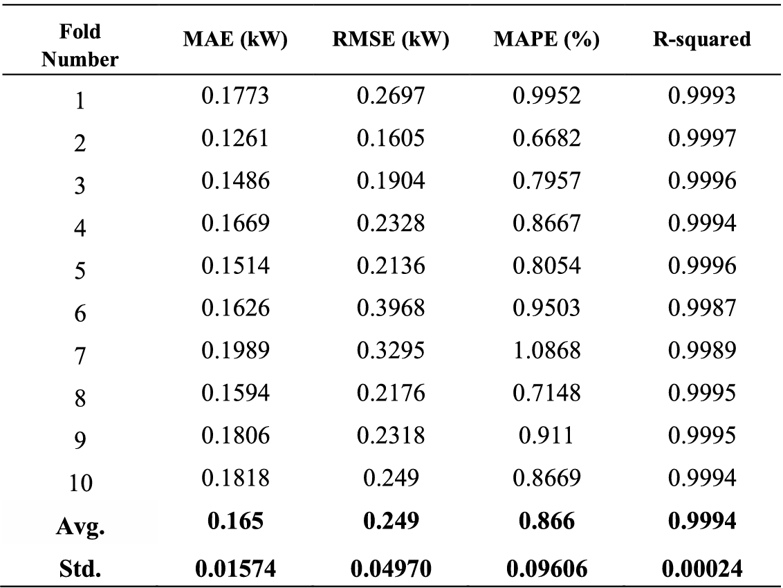
Results and Discussion
(a) Original table
(b) Experimental table
Fold Number | MAE (kW) | RMSE (kW) | MAPE (%) | R-squared
1 | 0.194106 | 0.27829 | 0.93398 | 0.999294
2 | 0.198931 | 0.262215 | 0.952896 | 0.999302
3 | 0.161475 | 0.29834 | 0.793821 | 0.99907
4 | 0.192752 | 0.269674 | 1.016883 | 0.999317
5 | 0.206243 | 0.419884 | 1.188685 | 0.998307
6 | 0.164589 | 0.230978 | 0.781186 | 0.999518
7 | 0.206469 | 0.327119 | 0.858542 | 0.998983
8 | 0.191862 | 0.301785 | 0.976863 | 0.999112
9 | 0.166564 | 0.213396 | 0.880673 | 0.999546
10 | 0.19486 | 0.305161 | 1.008449 | 0.99876
Avg. | 0.187785 | 0.290684 | 0.939198 | 0.999121
Std. | 0.017081 | 0.057111 | 0.120527 | 0.000373
TABLE 2. Results of performance metrics for energy predicting of HL.

Slide 15
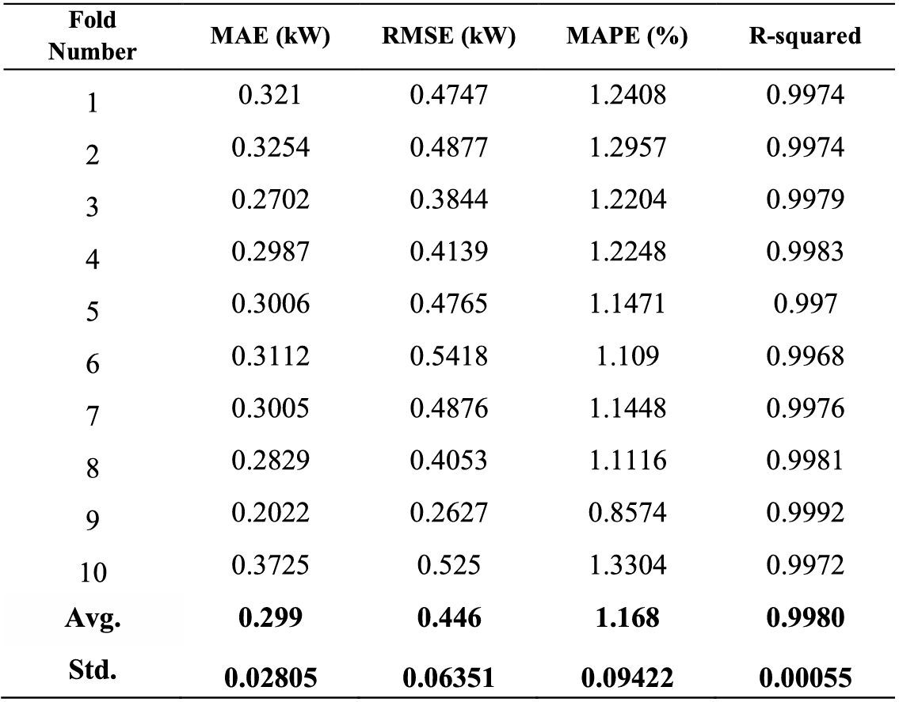
Results and Discussion
(a) Original table
(b) Experimental table
Fold Number | MAE (kW) | RMSE (kW) | MAPE (%) | R-squared
1 | 0.353798 | 0.537199 | 1.309914 | 0.997079
2 | 0.297095 | 0.423075 | 1.140242 | 0.997927
3 | 0.319763 | 0.500917 | 1.221975 | 0.997052
4 | 0.352545 | 0.496526 | 1.470156 | 0.997224
5 | 0.374662 | 0.600763 | 1.393107 | 0.996307
6 | 0.40214 | 0.573561 | 1.566273 | 0.996597
7 | 0.4109 | 0.589612 | 1.507326 | 0.996185
8 | 0.32727 | 0.482912 | 1.166158 | 0.997382
9 | 0.301474 | 0.39535 | 1.219702 | 0.998242
10 | 0.270597 | 0.426214 | 1.079473 | 0.997528
Avg. | 0.341025 | 0.502613 | 1.307433 | 0.997152
Std. | 0.046116 | 0.07267 | 0.168542 | 0.000663
TABLE 3. Results of performance metrics for energy predicting of CL.

Slide 16
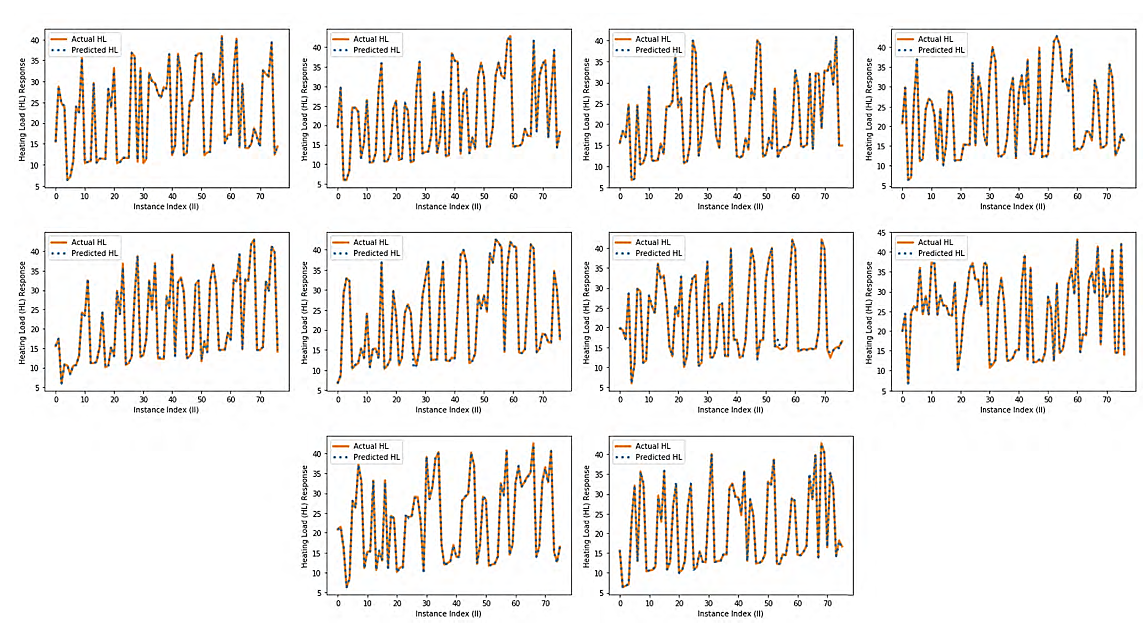
Results and Discussion
Actual and predicted energy values of heating load
(a) Original figure
(b) Experimental figure

Slide 17
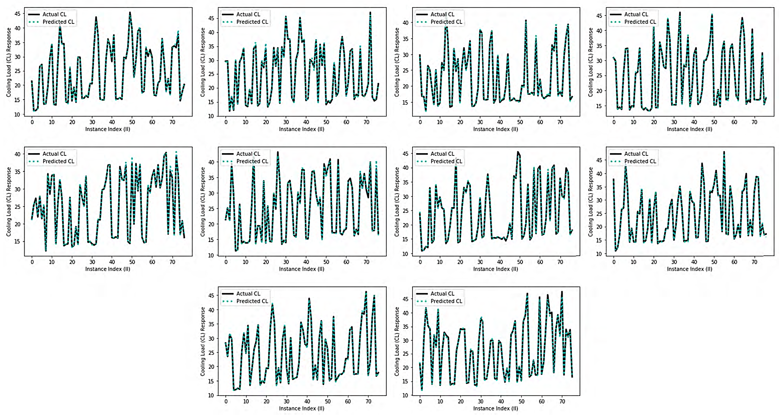
Results and Discussion
Actual and predicted energy values of cooling load
(a) Original figure
(b) Experimental figure

Slide 18
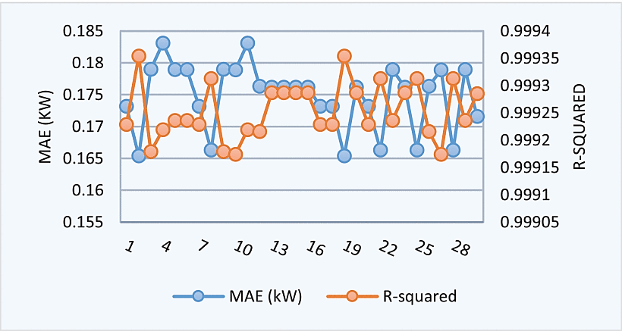
Results and Discussion
(a) Original figure
(b) Experimental figure
FIGURE 7. The relation between R-Squared and MAE values for HL in 30 times run

Slide 19
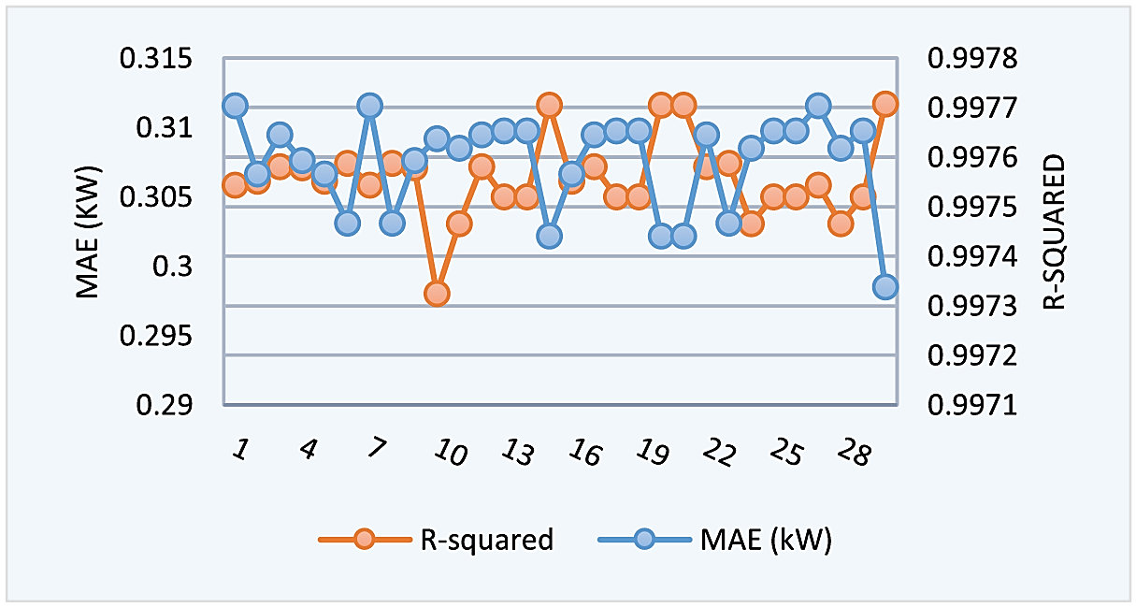
Results and Discussion
(a) Original figure
(b) Experimental figure
FIGURE 9. The relation between R-Squared and MAE values for CL in 30 times run

Slide 20
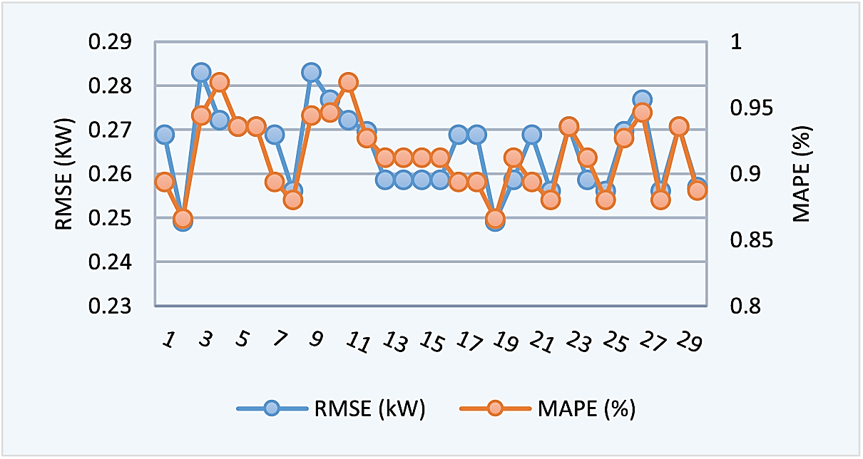
Results and Discussion
(a) Original figure
(b) Experimental figure
FIGURE 8. The relation between RMSE and MAPE values for HL in 30 times run

Slide 21
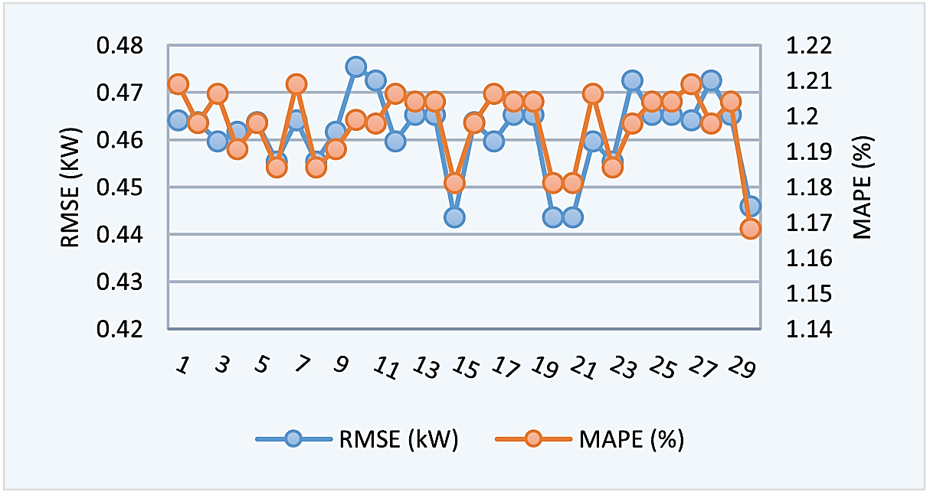
Results and Discussion
(a) Original figure
(b) Experimental figure
FIGURE 10. The relation between RMSE and MAPE values for CL in 30 times run

Slide 22
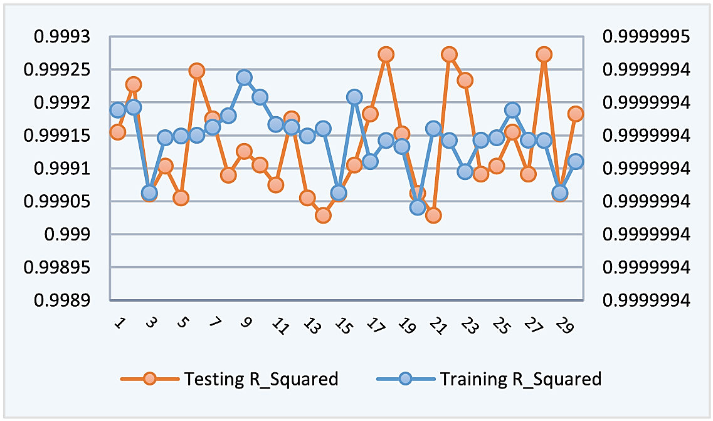
Results and Discussion
(a) Original figure
(b) Experimental figure
FIGURE 11. Comparison results of R-Squared between training and testing set for HL in the 30-times run of 10-cross validation.

Slide 23
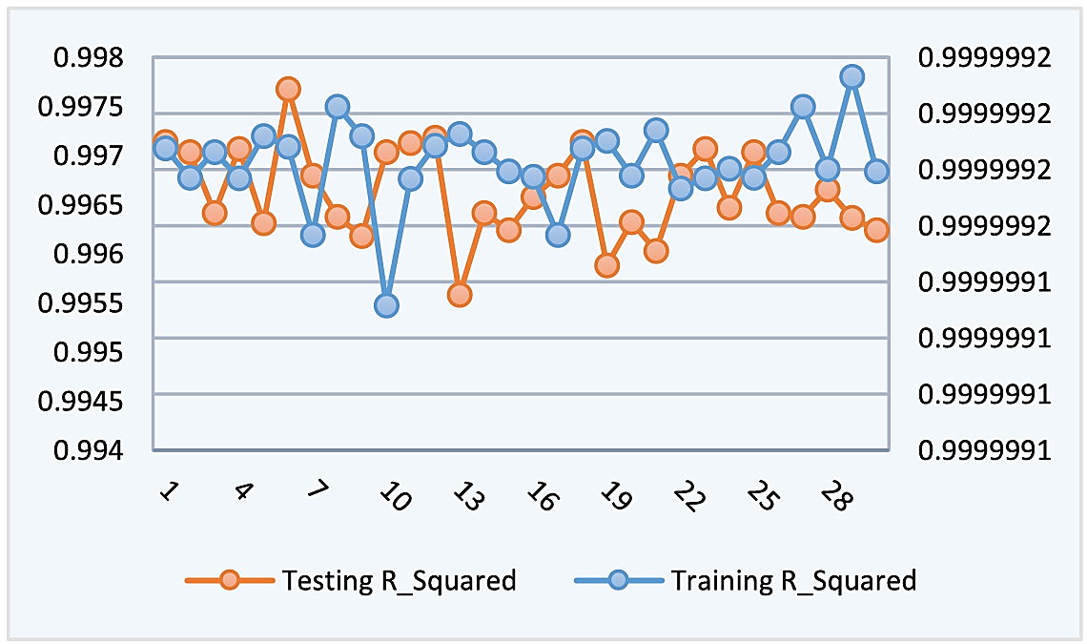
Results and Discussion
(a) Original figure
(b) Experimental figure
FIGURE 12. Comparison results of R-Squared between training and testing set for CL in the 30-times run of 10-cross validation.

Slide 24
Results and Discussion
Heating Load
Cooling Load
Ref | Model | MAE (kW) | RMSE (Kw) | MAPE (%) | R-squared
Tasnas and Xifara (2012) | Random forest | 0.51 | - | 2.2 | -
Chen and Cao (2014) | Ensemble model | 0.34 | 0.46 | - | 0.998
Chou and Bui (2014) | Ensemble model | 0.236 | 0.35 | 1.1 | 0.999
Castelli et al. (2015) | Genetic model | 0.38 | - | 0.43 | -
Duarte et al. (2017) | Neural network | 0.315 | 0.22 | 1.4 | 0.998
Goliatt et al. (2018) | Gaussian process | 0.251 | 0.38 | 1.3 | 0.999
Proposed by authors | XGBoost ensemble | 0.175 | 0.265 | 0.913 | 0.9993
My experimental results | XGBoost ensemble | 0.187 | 0.291 | 0.939 | 0.9991
Ref | Model | MAE (kW) | RMSE (Kw) | MAPE (%) | R-squared
Tasnas and Xifara (2012) | Random forest | 1.42 | - | 4.6 | -
Chen and Cao (2014) | Ensemble model | 0.68 | 0.97 | - | 0.99
Chou and Bui (2014) | Ensemble model | 0.89 | 1.57 | 3.5 | 0.986
Castelli et al. (2015) | Genetic model | 0.97 | - | 3.4 | -
Duarte et al. (2017) | Neural netwrok | 0.565 | 0.84 | 2.3 | 0.991
Goliatt et al. (2018) | Gaussian process | 0.448 | 0.67 | 1.8 | 0.998
Proposed by authors | XGBoost ensemble | 0.307 | 0.461 | 1.197 | 0.998
My experimental results | XGBoost ensemble | 0.341 | 0.502 | 1.307 | 0.997

Slide 25
Conclusion
Robust Model & Experimental Results
Implication & Future Works
Developed an ensemble learning approach using the XGBoost algorithm
Achieved lower mean square error (MSE) and higher accuracy compared to state-of-the-art approaches
Demonstrated stability in predictions across different test runs
Effectively mitigated overfitting issues, providing reliable predictions for heating load (HL) and cooling load (CL)
XGBoost can be a valuable addition for predicting building energy loads
Helps building engineers make informed decisions to design energy-efficient buildings
Further improve the model by integrating more diverse datasets and refining feature selection techniques
Investigate the model's performance in real-world scenarios and its adaptability to different climatic conditions

